Slide 1
SECRETARY OF STATE VOTECAL PROJECT CACEO New Law Conference Presentation
December 16, 2016

Slide 2
Agenda
Project Status
Confidential Voters – Public Safety Officers
Demonstrations – VoteCal Online Voter Registration and DMV COA
Conditional Voter Registration
Wrap Up

Slide 3
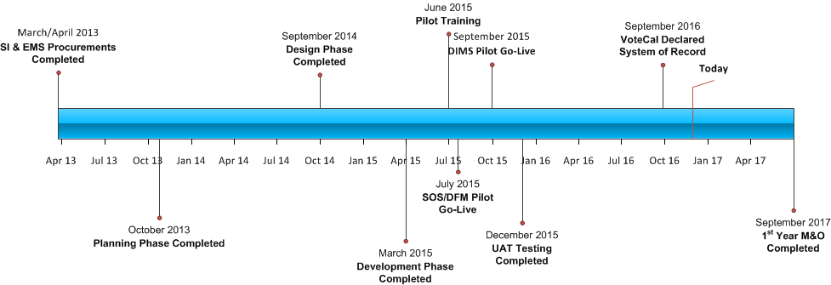
Project Status

Slide 4
Project status
VoteCal declared System of Record on September 26, 2016
Started Phase VII, Maintenance and Operations period, beginning October 2016
Monitoring performance and data
Responding to Help Desk tickets
Assessing and – if approved – implementing change requests
Improved functionality
Support changes in election law

Slide 5
Confidential voters – public safety officers
Background
Initial guidance document on Confidential Voters was distributed in September 2016
VoteCal includes functionality to automatically expire the confidential status of Peace Officers two years after they establish it
Now that VoteCal is the system of record, we need to initiate this functionality
The SOS has established a plan to help counties transition to using this functionality
Notes:
Back in September we sent counties a guidance document explaining how VoteCal and the EMSs’ handled confidential voters. The guidance document included information about how, as mandated by law, VoteCal would automatically expire the confidential status of Peace Officers after a 2 year period. This functionality has not been activated yet, but now that VoteCal is the System of Record, we are required to do so.

Slide 6
Confidential voters – Public safety officers
Transition Plan
Step | Activity | Date | Owner
1 | Ensure all confidential voters are entered into the local EMS | December 31, 2016 | Counties
2 | Provide counties with a report of all public safety officers whose confidential status will expire on or before June 30, 2017 | January 2017 | SOS
3 | Contact the public safety officers and inform them their confidential status will expire, provide re-application information | January 2017 through April 3, 2017 | Counties
4 | Turn on automatic expiration functionality (status will expire for all voters whose status was set to expire on or before April 3, 2017) | April 3, 2017 | SOS
5 | Receive and respond to “Confidential Voter Warning” and “Confidential Voter Status Expired” messages as appropriate | April 4, 2017 – On-Going | Counties
Notes:
Back in September we sent counties a guidance document explaining how VoteCal and the EMSs’ handled confidential voters. The guidance document included information about how, as mandated by law, VoteCal would automatically expire the confidential status of Peace Officers after a 2 year period. This functionality has not been activated yet, but now that VoteCal is the System of Record, we are required to do so.

Slide 7
Confidential voters – public safety officers
Confidential Voters Guidance Document
Detailed explanation of VoteCal’s confidential voter functionality
Guidance on responding to EMS messages and conducting outreach to voters
Sample notices that can be used for outreach when:
A confidential public safety officer’s status in your county is expiring
When a public safety officer moves into your county and your Board of Supervisors has approved a public safety officer program (he or she must reapply for confidential status in the new county)
When a public safety officer moves into your county and your Board of Supervisors has not approved a public safety officer program (his or her voter registration will remain confidential for 60 days before it will appear in public records and reports)
Notes:
Back in September we sent counties a guidance document explaining how VoteCal and the EMSs’ handled confidential voters. The guidance document included information about how, as mandated by law, VoteCal would automatically expire the confidential status of Peace Officers after a 2 year period. This functionality has not been activated yet, but now that VoteCal is the System of Record, we are required to do so.

Slide 8
DMV COA and Votecal online voter registration demonstrations
The SOS is planning to initiate VoteCal’s DMV COA and online voter registration functionality in January 2017
Functionality and business processes will change
Webinars will be held in January to:
Explain the functionality
Demonstrate the functionality in both VoteCal and your EMS

Slide 9
Conditional voter registration
Conditional Voter Registration (CVR) is effective January 1, 2017
CVR allows registrants to go to a county election official’s permanent or satellite office from E-14 to election day to register, obtain, and cast a CVR ballot
The CACEO’s CVR Committee, the BPC, the SOS, and the EMS vendors have identified the changes to VoteCal and the EMSs required to support CVR
Changes to VoteCal and the EMSs will be implemented in three phases

Slide 10
Conditional voter registration
Phase 1 – January 2017
Includes the basic functionality required to support CVR:
Addition of a new voting method code, Conditional Voter Registration (CVR)
Registrants through the public access website will receive a message to go to their county election official’s office to receive a CVR ballot
EMSs will provide counties with a report identifying voters who have moved in or out of their county during the CVR timeframe
DIMS will modify DIMS.net to search and display ballot status information for statewide searches; DFM will modify EIMS to store ballot status information for an election
EMSs will be modified to immediately send ballot status information to VoteCal
VoteCal and the EMSs will internally capture, store, and display CVR ballot status information (ballot issued, accepted, rejected, counted)
CVR ballot status information (counted/not counted) will be displayed on the public access website
Standardized values for CVR provisional ballot reject reason codes will be implemented in March 2017

Slide 11
Conditional voter registration
Phase 2 – June 2017
Improves Phase 1 functionality by providing an automated validation check to help counties determine whether to issue or accept a CVR provisional ballot
Phase 3 – January 2018
Anticipates the implementation of vote centers through modifications to VoteCal, the EMSs, and infrastructure components
Adds a validation check that allows and/or prevents a ballot from being issued/accepted for a specific election, displays the results
Allows counties – under specific circumstances – to override and issue a ballot

Slide 12
Conditional voter registration
Next steps:
VoteCal and the EMSs
Phase 1 functionality changes are included in the December 2016 releases for VoteCal and the EMSs
EMSs will utilize normal procedures to notify counties of release procedures and timeframes, contact your EMS for additional information
DIMS release will be available Friday, December 16, 2016 in the evening
DFM release is currently available
VoteCal downtime scheduled for Sunday December 18, 2016 from 7:00 AM to 7:00 PM
Counties
Review the “Conditional Voter Registration – FAQ’s for Elections Officials” document (distributed by the CACEO’s CVR committee) and the “Guidance: Conditional Voter Registration” document (distributed by the VoteCal project team) with you staff
SOS
CVR guidance document available today by hardcopy; will also be distributed electronically and posted on the county communication portal

Slide 13
Wrap Up
Ken White will distribute the materials from this meeting
Reminder: VoteCal will be down Sunday December 18, 2016 from 7 AM to 7 PM
Coming Soon: Invitations to the DMV COA and online registration demonstrations
For VoteCal and EMS questions or problems, contact:
VoteCal Help Desk: (888) VOTECAL; votecalhelp@sos.ca.gov
DFM Help Desk: (949) 859-8700 or (888) 336-3297(during business hours); (888) 336-6483 (after business hours); SUPPORT@DFMAssociates.com
DIMS Help Desk: (800) 553-DIMS or (800) 553-3467; DIMSHELP@essvote.com

